Slide 1
AutoMatica
Build Smarter, Not Harder.
Team Mu

Slide 2

AutoMatica
Automates publishing of Customization packages
Schedule you're publishing and work smarter
Notify your developers/ISV/Partners/Customer
Share logs/trace for troubleshooting with developers
Fully integrated for future automations

Slide 3
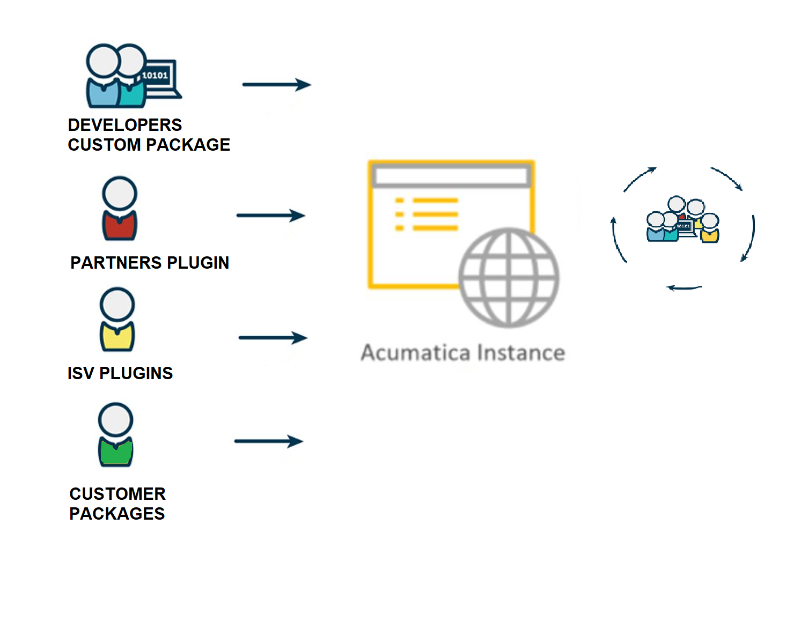
Problem
Compatibility issues with custom packages and newer versions of Acumatica.
Limited ability to publish packages on-demand in production environment.
Difficulty communicating and working with partners/ISVs to fix errors.
Difficulty remembering to publish packages during non-office hours.
Frustration caused by the challenges of customizing Acumatica.
Difficulty reaching out to other side of the development world to find a fix.

Slide 4
Let’s Demo AutoMatica
Let’s Demo

Slide 5
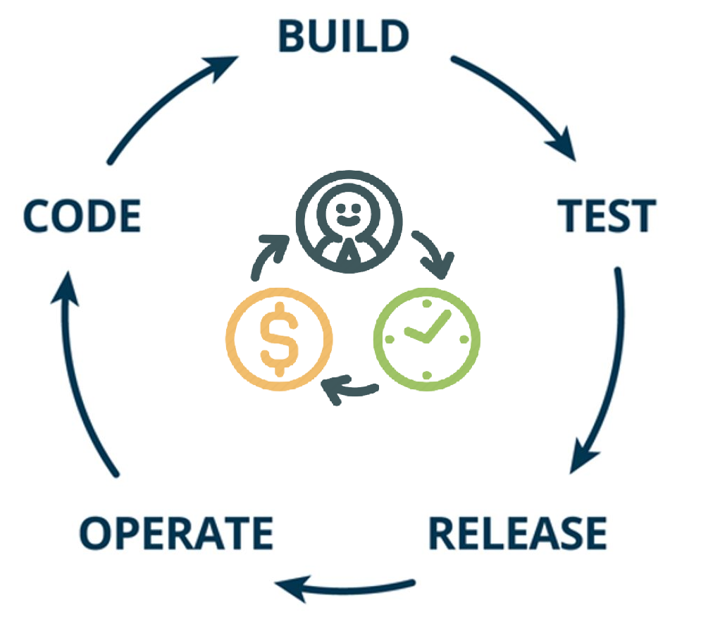
Benefits
Automation of Acumatica's Customization Manager, allowing for scheduling of upgrades and notifications during non-office hours.
Ability to setup a Customization Profile, specifying package owner information and contact details.
Notification of issues to package owner's technical teams via email, with trace details included.
Increased efficiency and organization in managing custom packages.
Reduced frustration and improved communication with package owners.
Better tracking and monitoring of package publishing process.

Slide 6
Future Enhancements
Push notifications – To alert users of the publication of the packages
Extend End-point – Remote capabilities of importing packages
Support Cases – Future integration
Snapshot automation
Ver 2.0

Slide 7







Brandon Sproul
Patrick Chen
Shawn Goodwin
Chetan Srinivas
Developer -
Developer – SPS Commerce
Martin Asscoiates
Product Manager - Kensium
Vidya
Paul Gilfoy
Harsha Sarjapur
Acumatica SME
Engineer – PriceKubecka
InfoSourcing Inc

